Slide 1

Power BI Visualisation
SOHEB DALVI

Slide 2
Power BI Visualisation Task-1

Slide 3
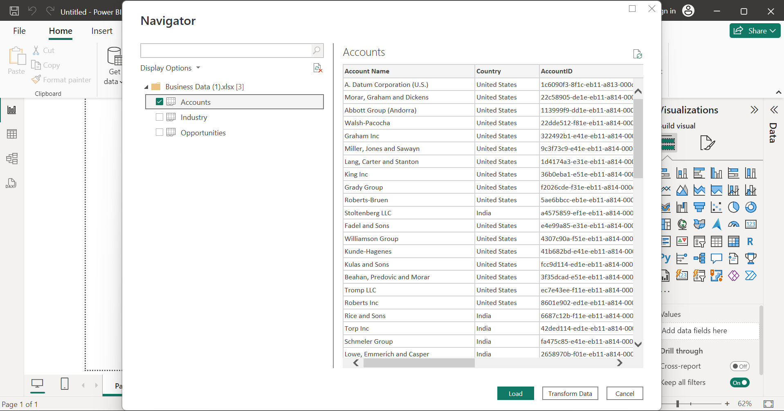
Import the Business data file into Microsoft PowerBI.

Slide 4
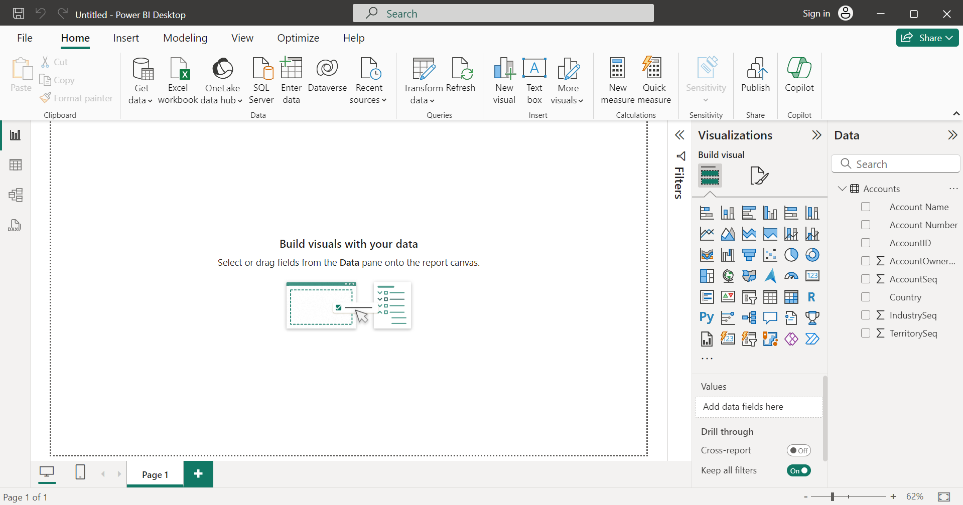
Load only the “Account” sheet from the workbook after transforming the data.

Slide 5
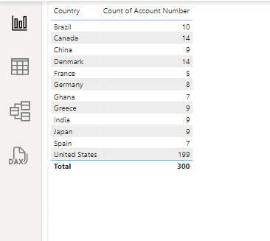
Represent the data, which includes the total count of account numbers against the country, in a tabular format.

Slide 6
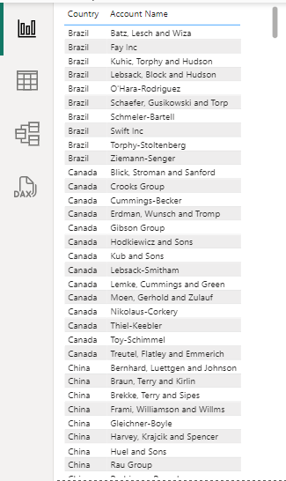
Insert another table and represent the data on the country-wise Account holder's name.

Slide 7
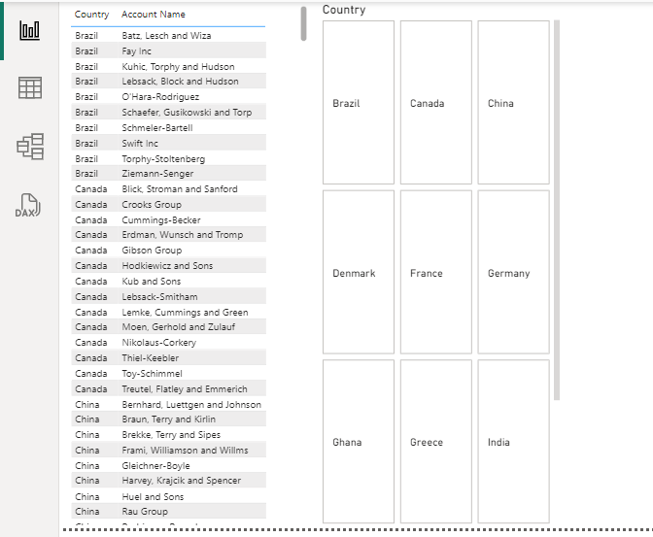
Insert a slicer from the visualisation section and add a country-wise filter

Slide 8
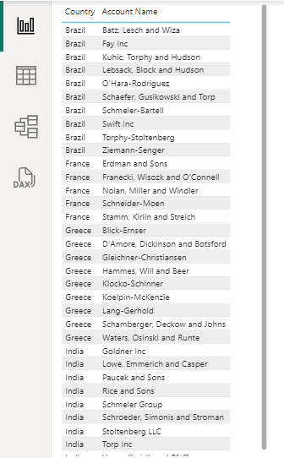
Represent the data of India, Brazil, Greece, and France together.

Slide 9
Power BI Visualisation Task-2

Slide 10
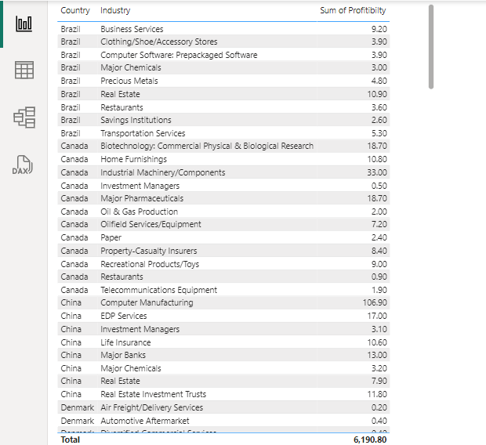
Country-wise industry and average profitability margin (in Percentage %)

Slide 11
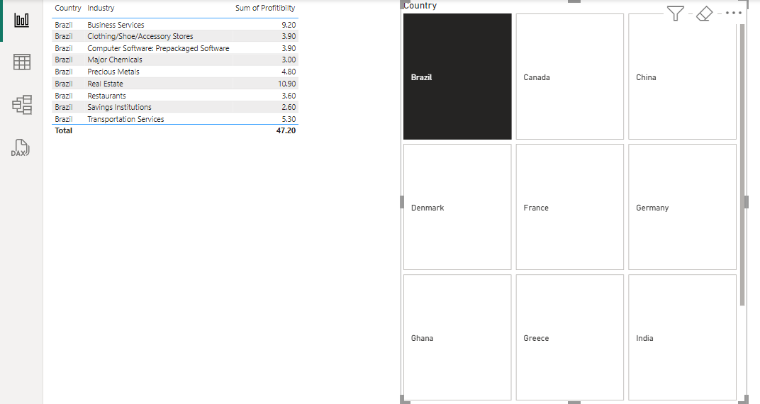
Add a separate filter so that country-wise industry and profitability margins can be shown based on the selective countries (There is no bar on country selection).

Slide 12
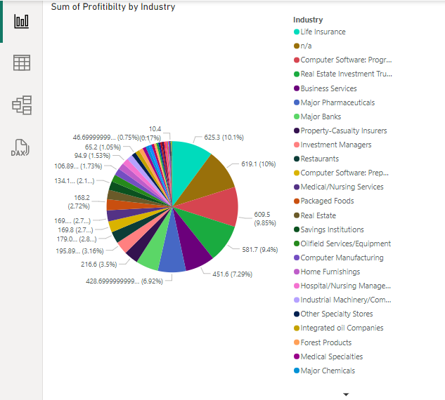
Industry-wise profitability percentage

Slide 13
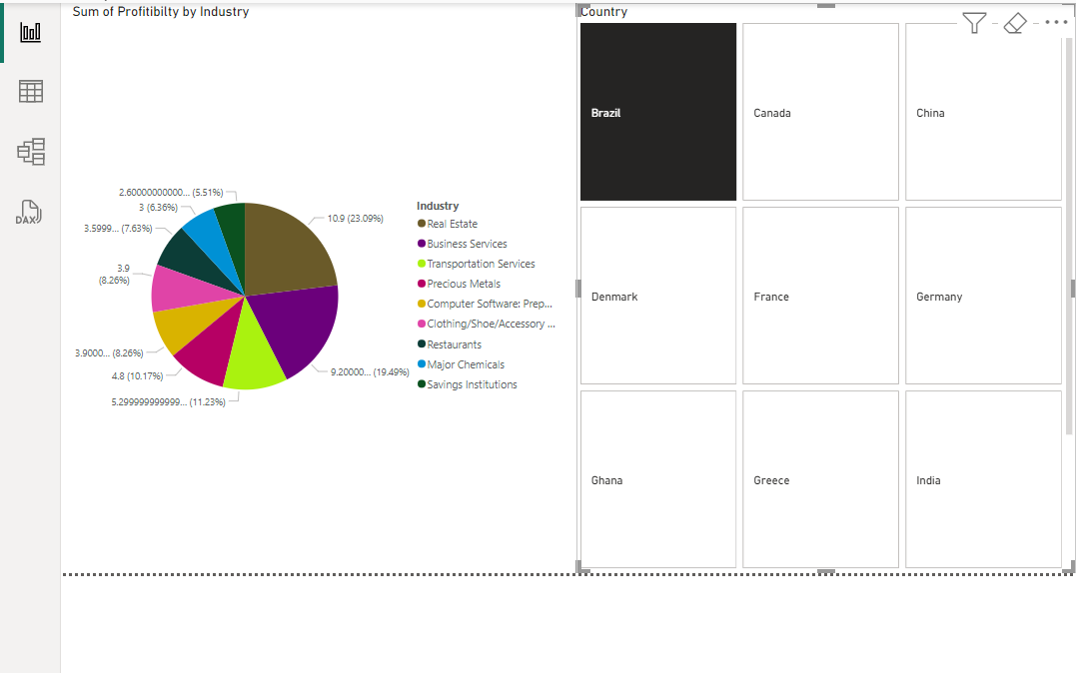
The data should be visualised in single or multiple country-wise

Slide 14
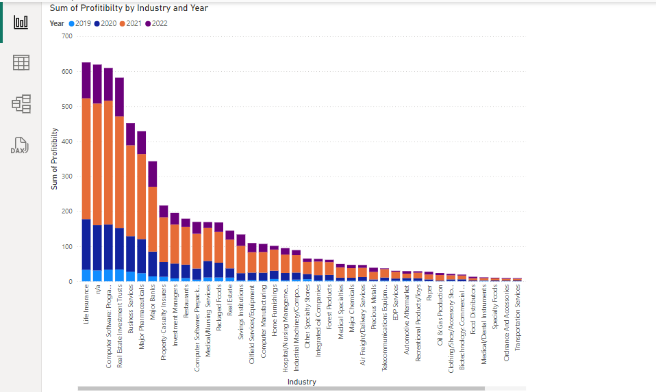
Present the data that shows industry-wise profitability trends by taking the Line & stacked column chart from the visualisation section.

Slide 15
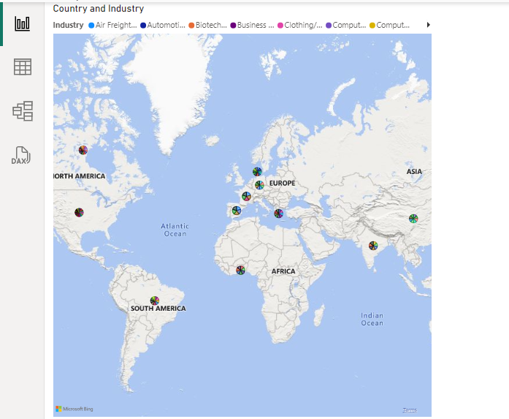
Present the data to show country-wise industry market values and industry wise presence by taking the map chart.

Slide 16
Thank you

